Slide 1
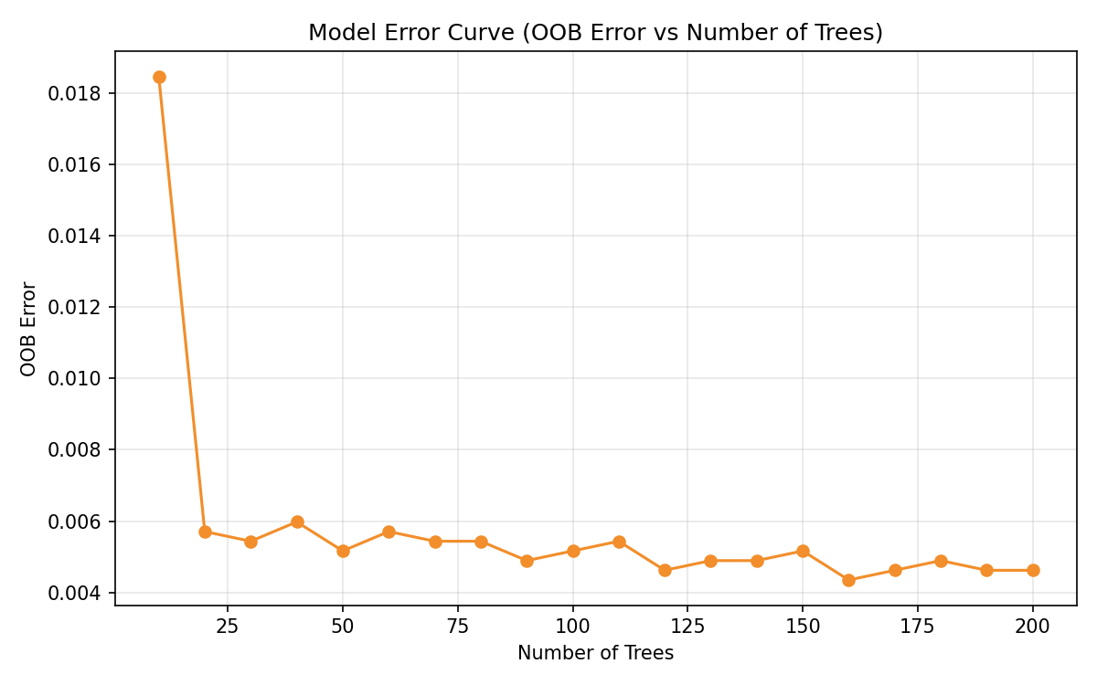
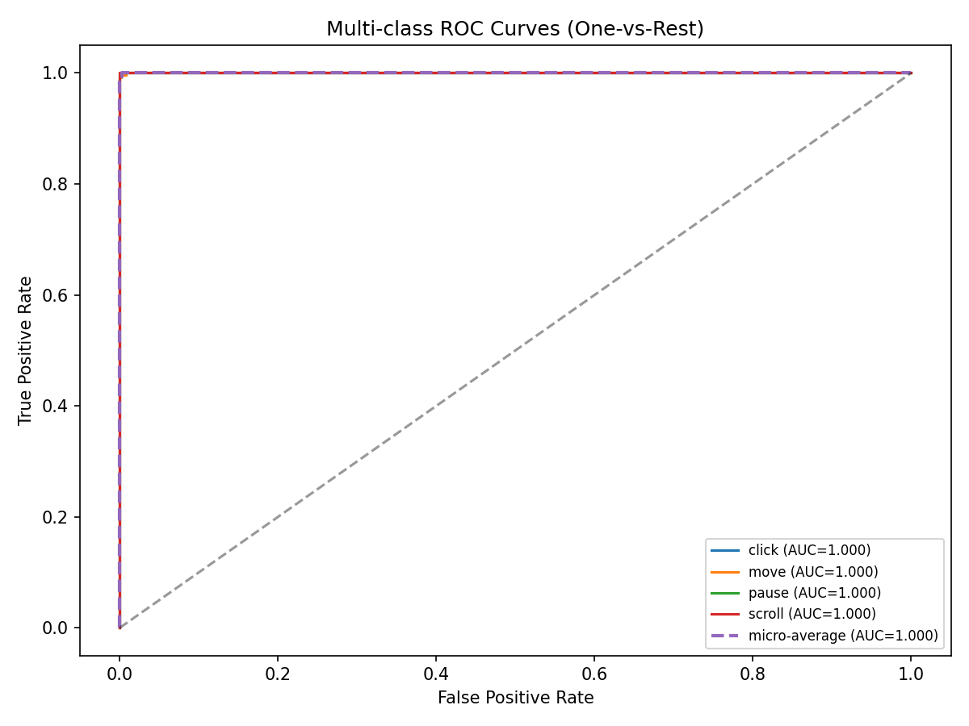
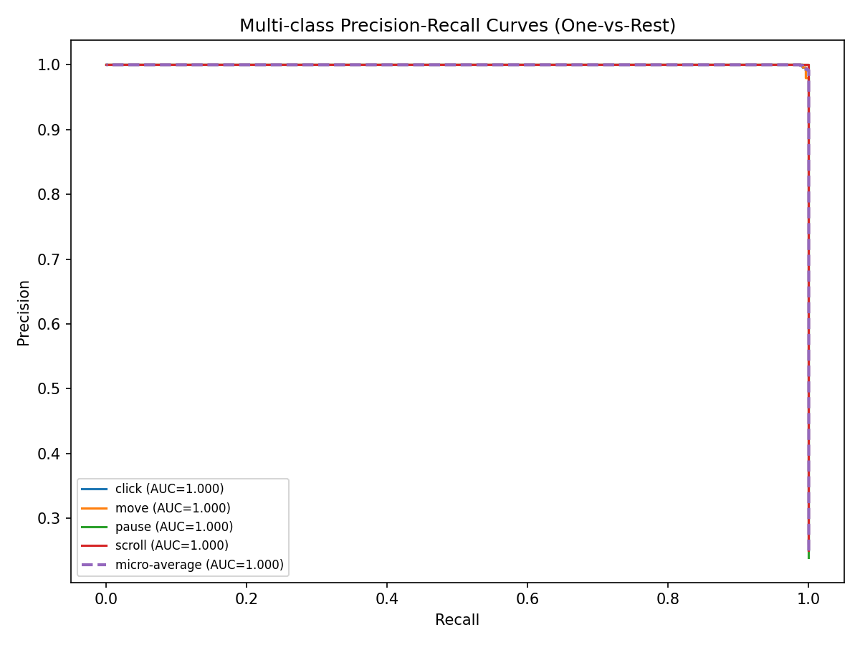
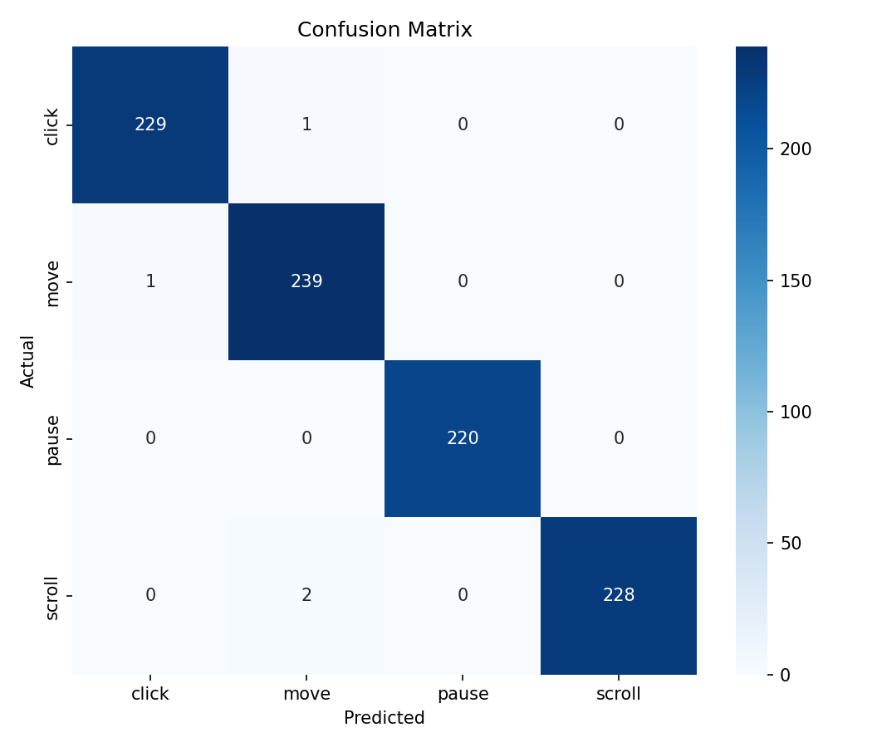
Gesture-Based Laptop Controller: One-Page Model Summary
Dataset
• 4600 samples, 63 landmark features, 4 gesture classes
• Classes: move, click, scroll, pause (near-balanced)
Model
• RandomForest (n_estimators=100, max_depth=15, min_samples_split=5, min_samples_leaf=2)
Key Results
• Test Accuracy: 0.9957
• Weighted Precision: 0.9957
• Weighted Recall: 0.9957
• Weighted F1-score: 0.9957
• ROC-AUC (micro): 1.0000
• PR-AUC (micro): 0.9999
OOB Error Curve
ROC Curves
Precision-Recall Curves
Confusion Matrix
Generated from sample dataset (gesture_data.csv) | Pipeline: MediaPipe landmarks -> RandomForest classifier

